Slide 1



E-Commerce Database Management System
Design, Implementation & Analytics
Presented to
Presented by
Tasfia Tabassum Faija
Lecturer
Northern University Bangladesh
Farjana Afroz(41230301722)
Mohtasim Billah Tanvir(41230301725)
Asif Ahmad(41230301762)
Md Mahabub Hasan(41230301762)

Slide 2


Table of Contants
1 | Project Overview
2 | Problem Statement & Our Solution
3 | Database Schema Design &Er diagram
4 | Key Tables & Structures & Technical Implementation
5 | Business Value & Applications & Future Use
6 | UI Snapshots - Home & Authentication

Slide 3



Project Overview
What We Built
Key Features
A complete relational database system for e-commerce operations
11 normalized tables with relationships and constraints
Comprehensive SQL queries for operations and analytics
Triggers for automated business processes
Sample data for demonstration and testing
User and role management
Product catalog with categories
Inventory management
Order processing system
Customer reviews and ratings
Discount and promotion management
Advanced analytical capabilities

Slide 4



Problem Statement
Challenges in E-Commerce Data Management
Handling complex product catalogs and categories
Managing user accounts and authentication
Processing orders and payments efficiently
Maintaining inventory accuracy
Tracking customer behavior and preferences
Generating business insights from data
Ensuring data integrity and consistency

Slide 5




Our Solution
A comprehensive database schema addressing all these challenges
Automated processes through triggers and constraints
Advanced queries for business intelligence

Slide 6


Database Schema Design
Users → Orders → Order Items → Products
Users → Shopping Cart → Products
Users → Product Reviews → Products → Categories
Products → Discounts
Orders → Payment Methods
Orders → Order Status Log
Categories → Products
Categories → Categories (self-join for hierarchy)

Slide 7


Key Tables & Structures
Core Operational Tables
Users & User Roles - Customer and admin management
Products & Categories - Catalog organization
Orders & Order Items - Transaction processing
Shopping Cart - Session management
Payment Methods - Transaction options
.

Slide 8

Key Tables & Structures
Support Tables
Discounts - Promotion management
Product Reviews - Customer feedback system
Order Status Log - Audit trail for orders

Slide 9


Advanced Features
Advanced Features
Automatic stock updates (trigger)
Dynamic rating calculations (trigger)
Order audit trail (logging)
Business analytics (advanced queries)

Slide 10
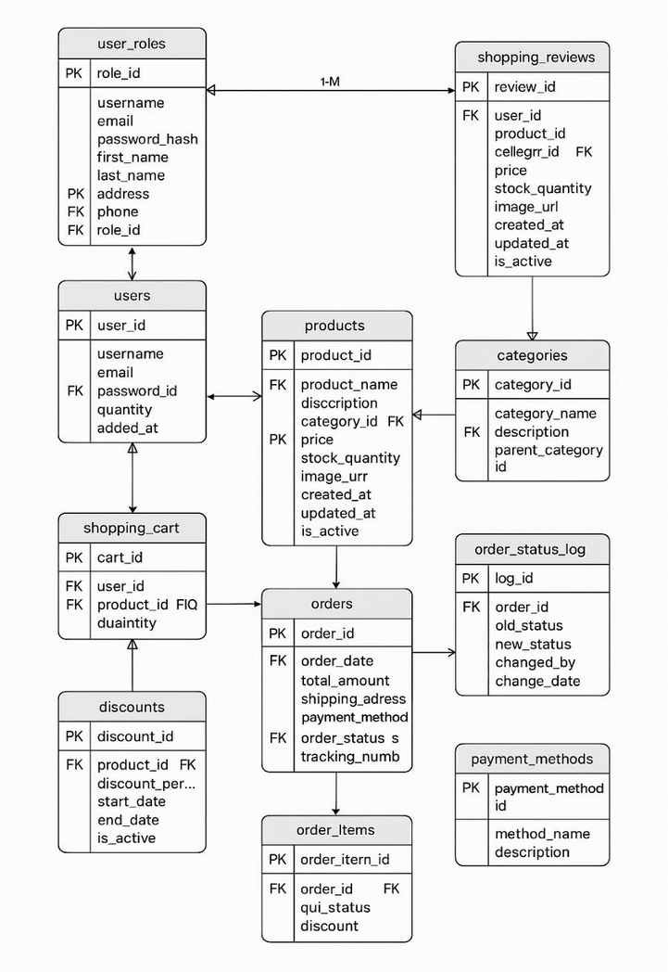
Advanced Features
ER Diagram:

Slide 11


Key Technical Features
Automation Examples
Analytics Capabilities
-- Auto-update inventory after orders
CREATE TRIGGER trg_update_stock
AFTER INSERT ON order_items
BEGIN
UPDATE products SET stock = stock - :NEW.quantity;
END;
Customer lifetime value calculation
Sales growth trends
Product performance metrics
Shopping behavior analysis

Slide 12




Technical Implementation
Database System
Frontend Integration
Oracle Database 11g/12c/19c
PL/SQL for stored procedures and triggers
SQL for data manipulation and querying
Technology: Built with HTML and CSS.
Design Principles:
Responsive design for various devices (mobile, desktop).
Intuitive navigation and user flow.
Modern and clean aesthetic.
Current State:
A static prototype demonstrating the look and feel of the final application.

Slide 13
Business Value
Operational Benefits
Sample Insight
Efficient order processing
Accurate inventory management
Personalized customer experiences
Data-driven decision making
Customer Segmentation Query:
Identifies VIP vs. regular customers
Enables targeted marketing
Improves retention strategies

Slide 14
Applications & Future Use
Immediate Applications
Future Enhancements
Online retail stores
Marketplace platforms
Inventory management systems
Business intelligence tool
To create a fully functional application, we need to connect the UI to the Database:
Server-Side Technology: (e.g., Node.js, Python Django, PHP).
REST API: To handle operations (GET products, POST orders, etc.).
Middleware: Oracle Instant Client to connect the server to the database.
Authentication: Secure user login and session management.

Slide 15

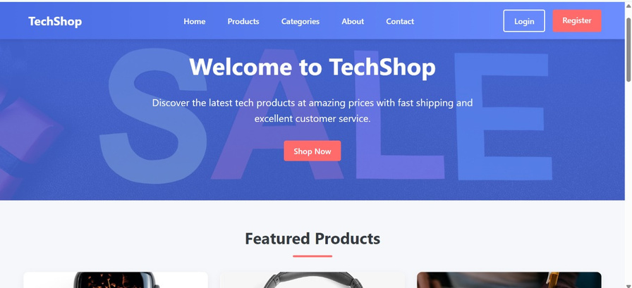
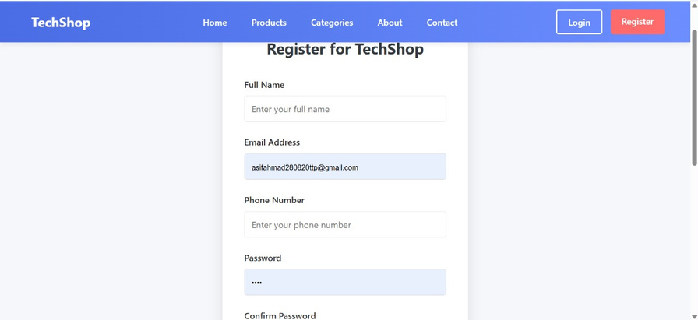
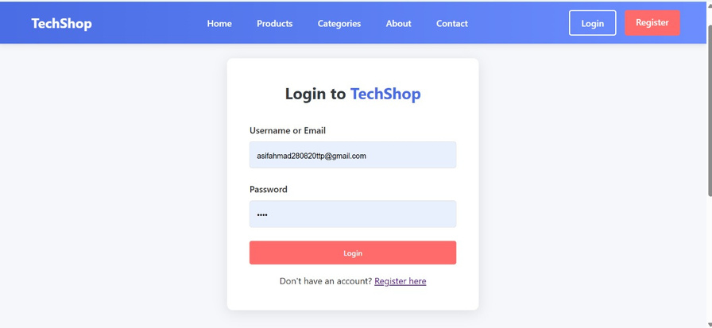
UI Snapshots - Home & Authentication

Slide 16
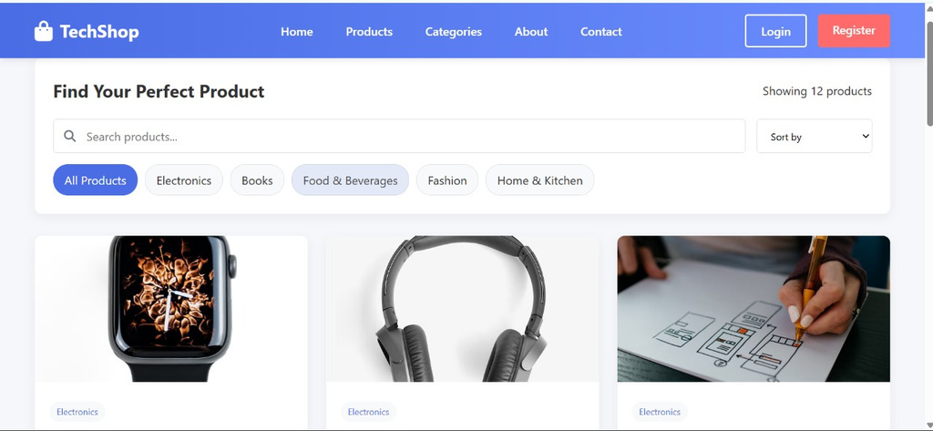
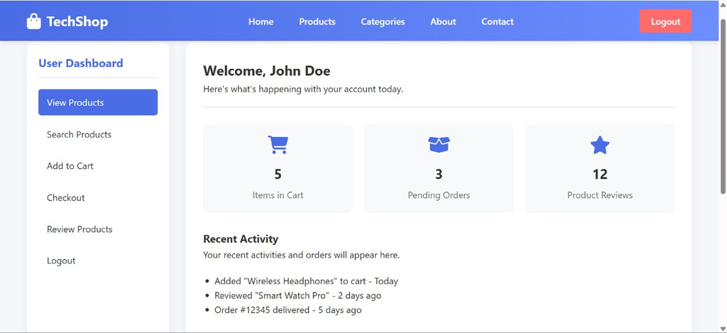
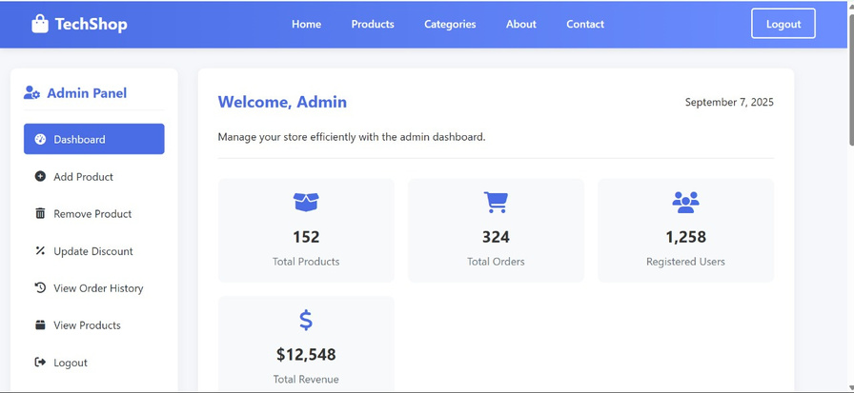
UI Snapshots - Product & Dashboard Views

Slide 17
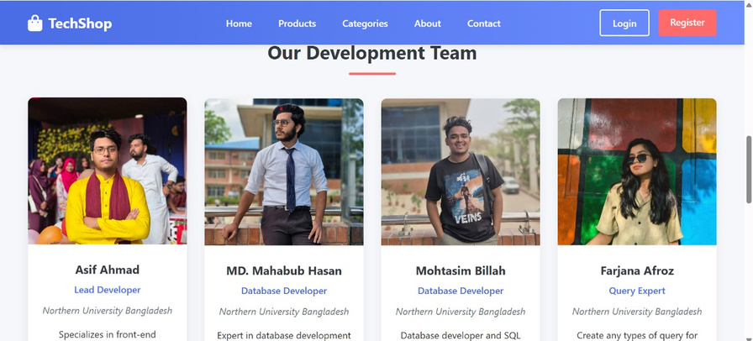
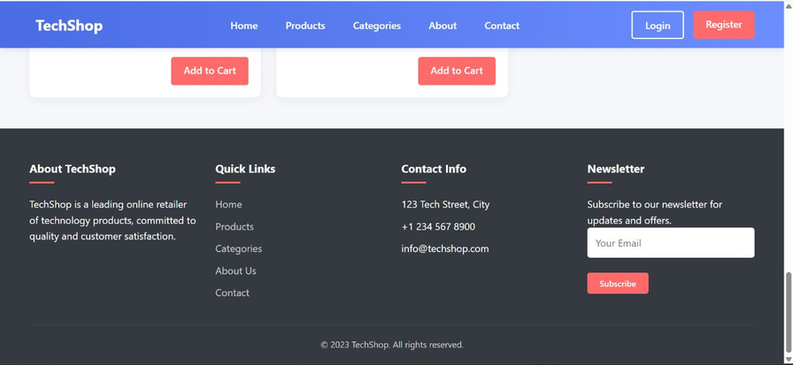
UI Snapshots - Product & Dashboard Views

Slide 18



Future Scope & Enhancements
To create a fully functional application, we need to connect the UI to the Database:
Server-Side Technology: (e.g., Node.js, Python Django, PHP).
REST API: To handle operations (GET products, POST orders, etc.).
Middleware: Oracle Instant Client to connect the server to the database.
Authentication: Secure user login and session management.
Phase 1: Connect product catalog & shopping cart.
Phase 2: Implement user authentication.
Phase 3: Develop order processing.
Phase 4: Build admin dashboard.

Slide 19
Thank you

